Slide 1
Image Classification
Ivica Dimitrovski
Notes:
Afternoon
Image and region categorization
Use one image , what do you see
Can see different, transfer knowledge
Can know a lot of things by seeing it a dog
Type of categorization

Slide 2
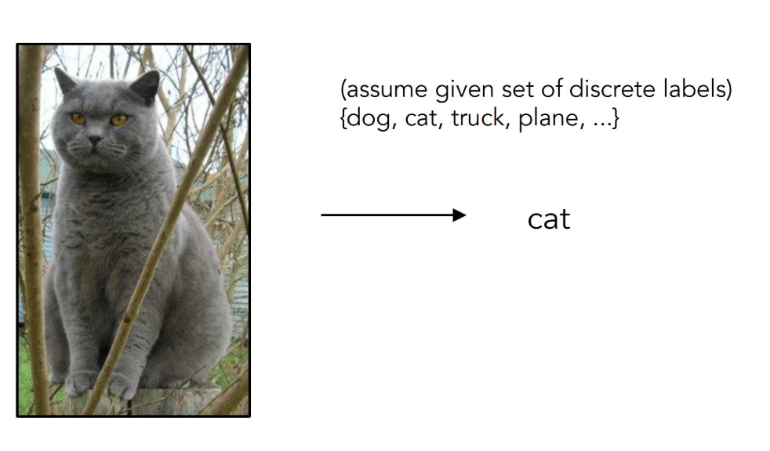
Image classification
A core task in Computer Vision
Image classification is the task of assigning a label or class to an entire image

Slide 3
Types of image classification (1)
Depending on the problem at hand, there are different types of image classification methodologies to be employed. These are binary, multiclass, multilabel, and hierarchical
‍Binary classification takes an either-or logic to label images, and classifies unknown data points into two categories
Example: when your task is to categorize benign or malignant tumors, analyze product quality to find out whether it has defects or not, and many other problems that require yes/no answers are solved with binary classification.

Slide 4
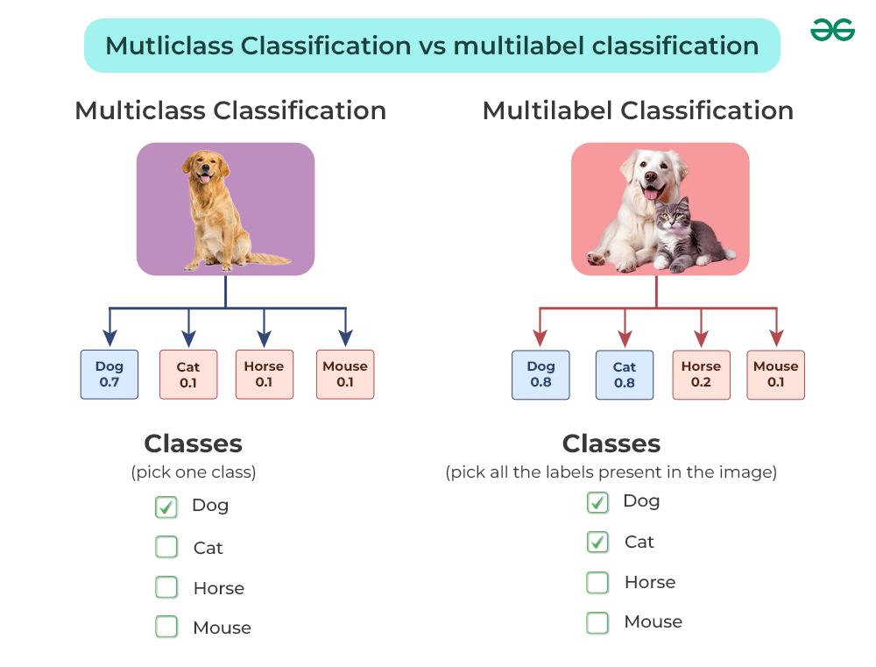
Types of image classification (2)
Multiclass: While binary classification is used to distinguish between two classes of objects, multiclass, as the name suggests, categorizes items into three or more classes
Multilabel: Unlike multiclass classification, where each image is assigned to exactly one class, multilabel classification allows the item to be assigned to multiple labels

Slide 5
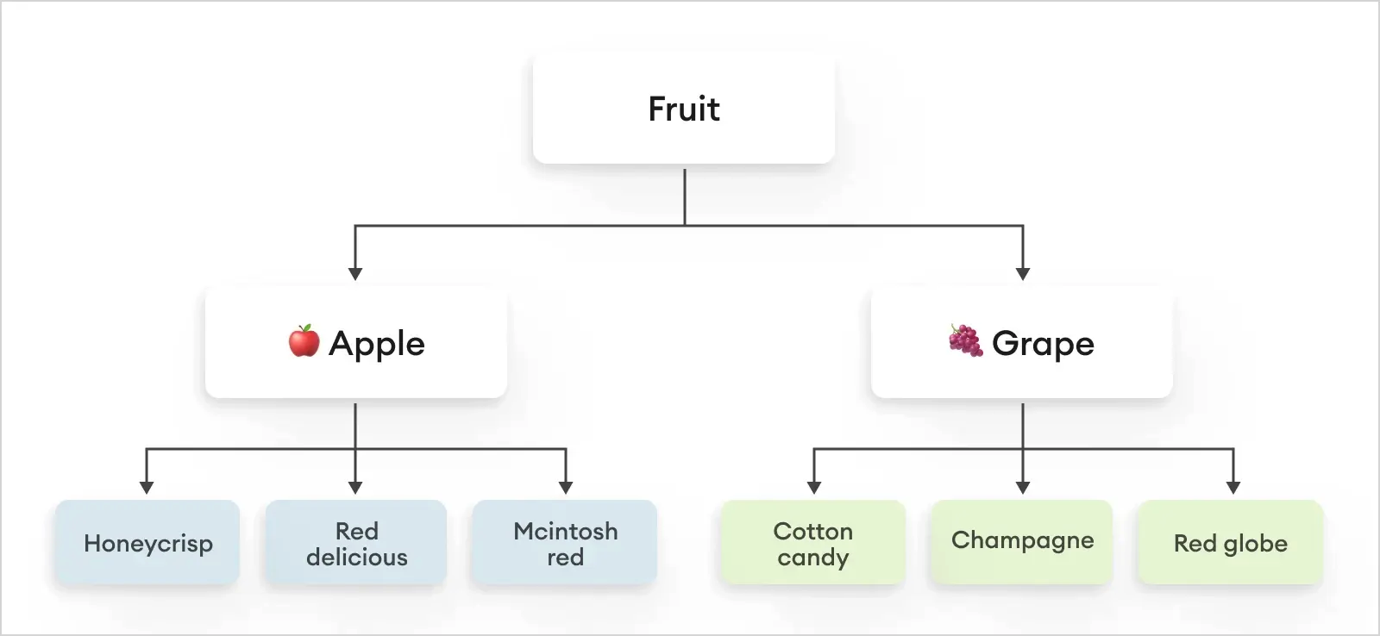
Types of image classification (3)
Hierarchical: Hierarchical classification is the task of organizing classes into a hierarchical structure based on their similarities, where a higher-level class represents broader categories and a lower-level class is more concrete and specific.

Slide 6
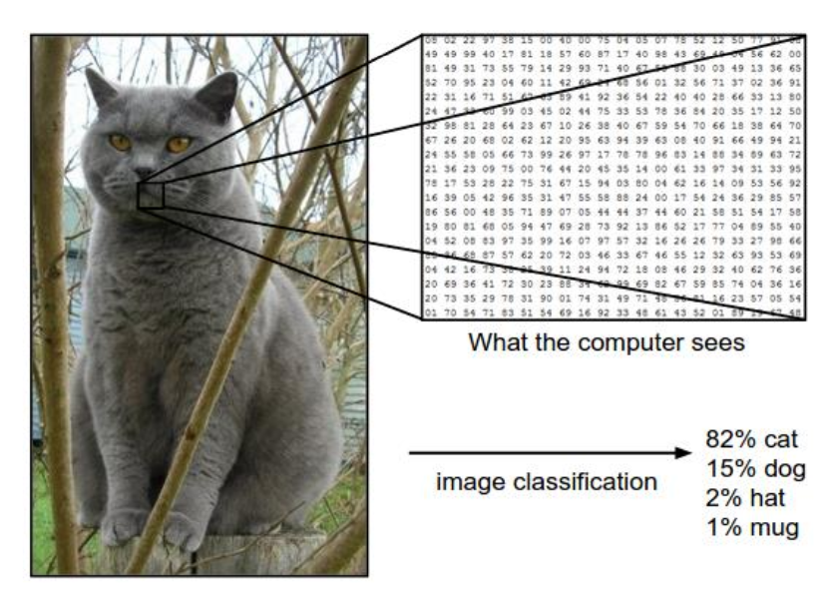
Image classification: Problem
Notes:
For example, in the image below an image classification model takes a single image and assigns probabilities to 4 labels, {cat, dog, hat, mug}. As shown in the image, keep in mind that to a computer an image is represented as one large 3-dimensional array of numbers. In this example, the cat image is 248 pixels wide, 400 pixels tall, and has three color channels Red,Green,Blue (or RGB for short). Therefore, the image consists of 248 x 400 x 3 numbers, or a total of 297,600 numbers. Each number is an integer that ranges from 0 (black) to 255 (white). Our task is to turn this quarter of a million numbers into a single label, such as “cat”.

Slide 7
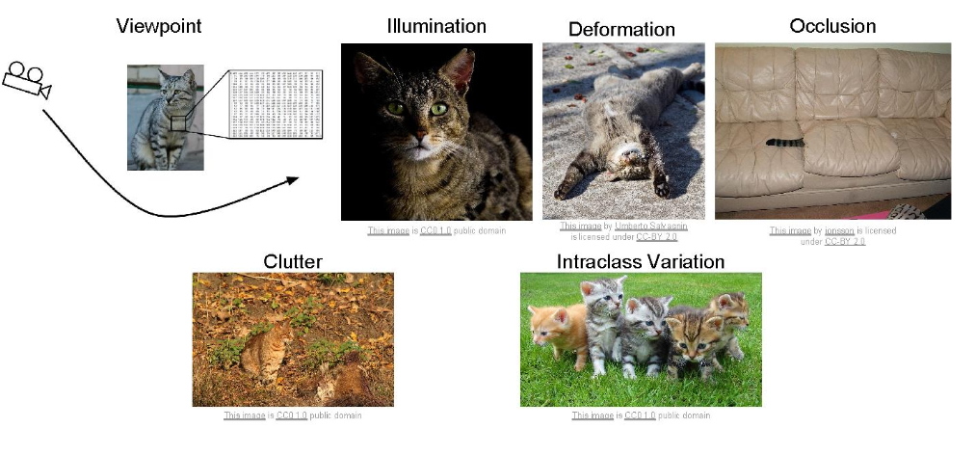
Challenges of classification
Notes:
Since this task of recognizing a visual concept (e.g. cat) is relatively trivial for a human to perform, it is worth considering the challenges involved from the perspective of a Computer Vision algorithm. As we present (an inexhaustive) list of challenges below, keep in mind the raw representation of images as a 3-D array of brightness values:

Slide 8
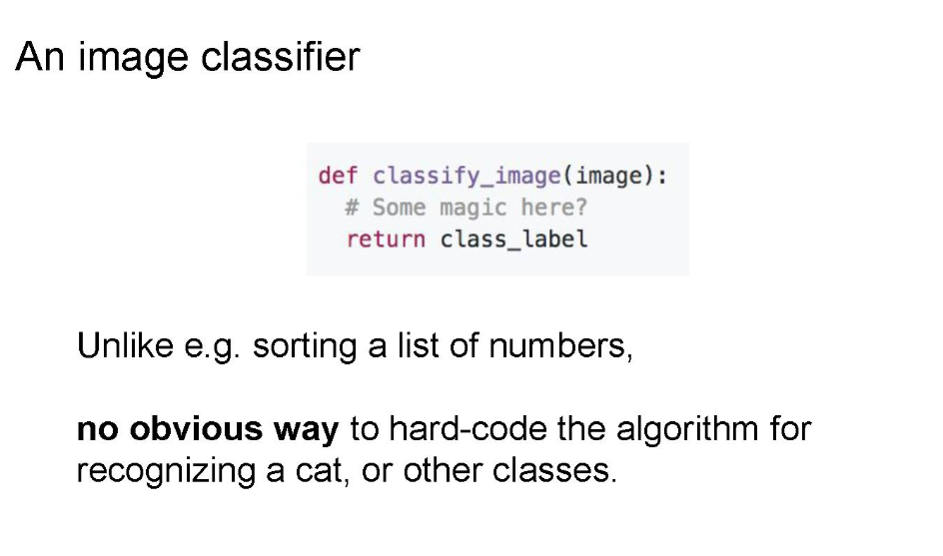
Image classifier
Notes:
How might we go about writing an algorithm that can classify images into distinct categories? Unlike writing an algorithm for, for example, sorting a list of numbers, it is not obvious how one might write an algorithm for identifying cats in images.

Slide 9
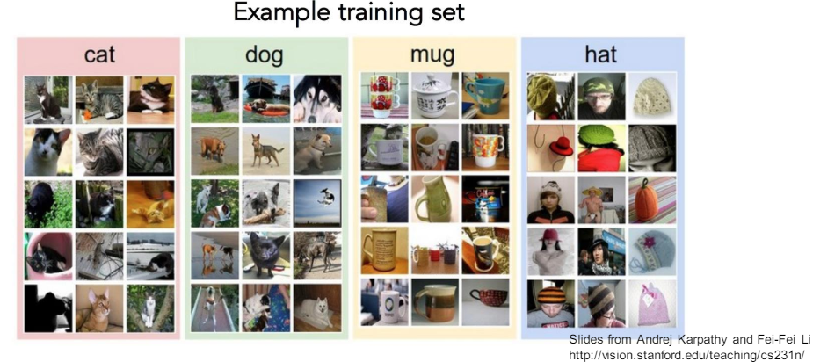
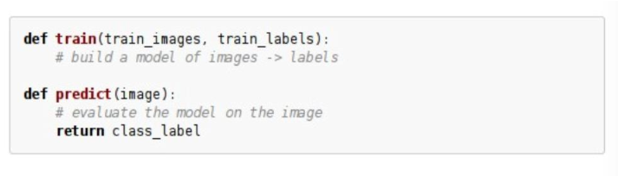
Data-driven approach
Collect a database of images with labels
Use Machine Learning (ML) to train an image classifier
Evaluate the classifier on test images
Notes:
we’re going to provide the computer with many examples of each class and then develop learning algorithms that look at these examples and learn about the visual appearance of each class. This approach is referred to as a data-driven approach, since it relies on first accumulating a training dataset of labeled images.
The image classification pipeline. We’ve seen that the task in Image Classification is to take an array of pixels that represents a single image and assign a label to it. Our complete pipeline can be formalized as follows:
Input: Our input consists of a set of N images, each labeled with one of K different classes. We refer to this data as the training set.
Learning: Our task is to use the training set to learn what every one of the classes looks like. We refer to this step as training a classifier, or learning a model.
Evaluation: In the end, we evaluate the quality of the classifier by asking it to predict labels for a new set of images that it has never seen before. We will then compare the true labels of these images to the ones predicted by the classifier. Intuitively, we’re hoping that a lot of the predictions match up with the true answers (which we call the ground truth).

Slide 10

Many classifiers to choose from
Image classification can be performed using Traditional Machine Learning or Deep Learning. Both approaches have distinct methodologies, advantages, and limitations

Slide 11
Traditional Machine Learning for Image Classification
Traditional machine learning relies on handcrafted features and classical classification algorithms
Workflow of Traditional ML for Image Classification
Feature Extraction: Extract predefined features like edges, textures, shapes, or color histograms using algorithms such as HOG (Histogram of Oriented Gradients), SIFT (Scale-Invariant Feature Transform), or LBP (Local Binary Patterns)
Feature Selection: Choose the most relevant features to reduce dimensionality and improve classification
Classifier Training: Train a machine learning classifier such as: Support Vector Machines (SVM), Random Forest, k-Nearest Neighbors (k-NN), Logistic Regression
Prediction: The trained classifier predicts the class of new images based on extracted features

Slide 12
Deep Learning for Image Classification
Deep learning eliminates manual feature extraction by using neural networks to learn features directly from raw images
Learn an end-to-end recognition system
By combining simple building blocks we can make more and more complex systems
For example in Image Classification, a non-linear map takes raw pixels directly to labels
Composition is at the core of deep learning methods
Each “simple function” will have parameters subject to learning
Workflow of Deep Learning for Image Classification
Data Preprocessing: Prepare the dataset, normalize images, and perform augmentation (e.g., rotation, flipping)
Model Training: Train a Convolutional Neural Network (CNN) such as: LeNet, AlexNet, VGGNet, ResNet, EfficientNet or Vision Transformer
Feature Learning: The CNN automatically learns hierarchical features, from edges (early layers) to complex shapes (deeper layers)
Classification: The final layer assigns probabilities to different classes

Slide 13
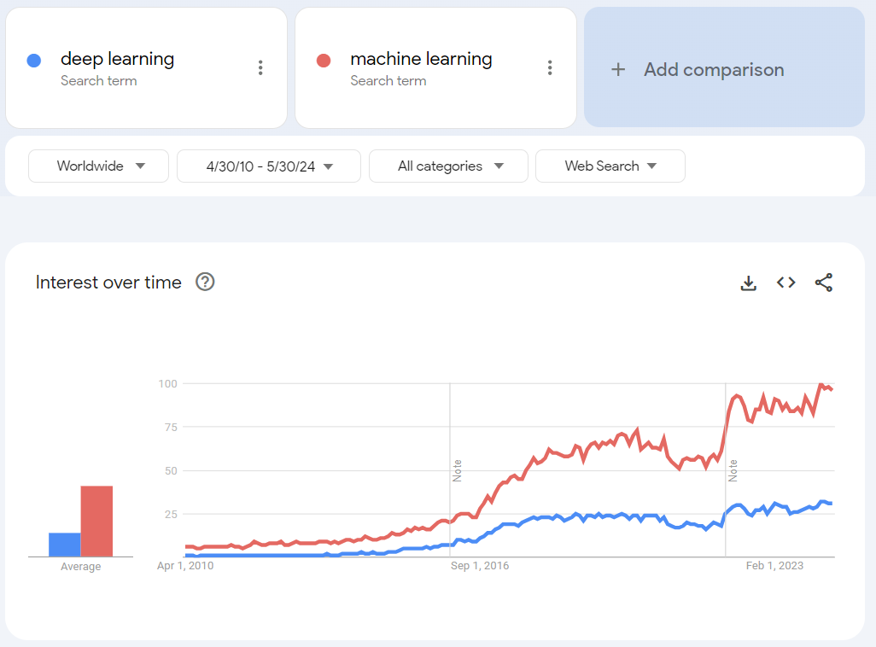
Why is Deep learning useful?
Manually designed features are often over-specified, incomplete, and take a long time to design and validate
Learned Features are easy to adapt, fast to learn
Deep learning provides a very flexible, learnable framework for representing world, visual, and linguistic information
Can learn both unsupervised and supervised
Effective end-to-end joint system learning
Utilize large amounts of training data
In ~2010 DL started outperforming other ML techniques first in speech and vision, then NLP

Slide 14
Neural Networks: Layers and Functionality
In a regular Neural Network there are three types of layers
Input Layers: It’s the layer in which we give input to our model. The number of neurons in this layer is equal to the total number of features in our data (number of pixels in the case of an image)
Hidden Layer: The input from the Input layer is then fed into the hidden layer. There can be many hidden layers depending on our model and data size. Each hidden layer can have different numbers of neurons which are generally greater than the number of features. The output from each layer is computed by matrix multiplication of the output of the previous layer with learnable weights of that layer and then by the addition of learnable biases followed by activation function which makes the network nonlinear
Output Layer: The output from the hidden layer is then fed into a logistic function like sigmoid or softmax which converts the output of each class into the probability score of each class
The data is fed into the model and output from each layer is obtained from the above step is called feedforward, we then calculate the error using an error function, some common error functions are cross-entropy, square loss error, etc. The error function measures how well the network is performing. After that, we backpropagate into the model by calculating the derivatives. This step is called Backpropagation which basically is used to minimize the loss

Slide 15
Convolution Neural Network
Convolutional Neural Network (CNN) is the extended version of artificial neural networks (ANN) which is predominantly used to extract the feature from the grid-like matrix dataset.
For example visual datasets like images or videos where data patterns play an extensive role
They have three main types of layers, which are:
Convolutional layer
Pooling layer
Fully-connected (FC) layer
The convolutional layer is the first layer of a convolutional network. While convolutional layers can be followed by additional convolutional layers or pooling layers, the fully-connected layer is the final layer. With each layer, the CNN increases in its complexity, identifying greater portions of the image. Earlier layers focus on simple features, such as colors and edges. As the image data progresses through the layers of the CNN, it starts to recognize larger elements or shapes of the object until it finally identifies the intended object

Slide 16
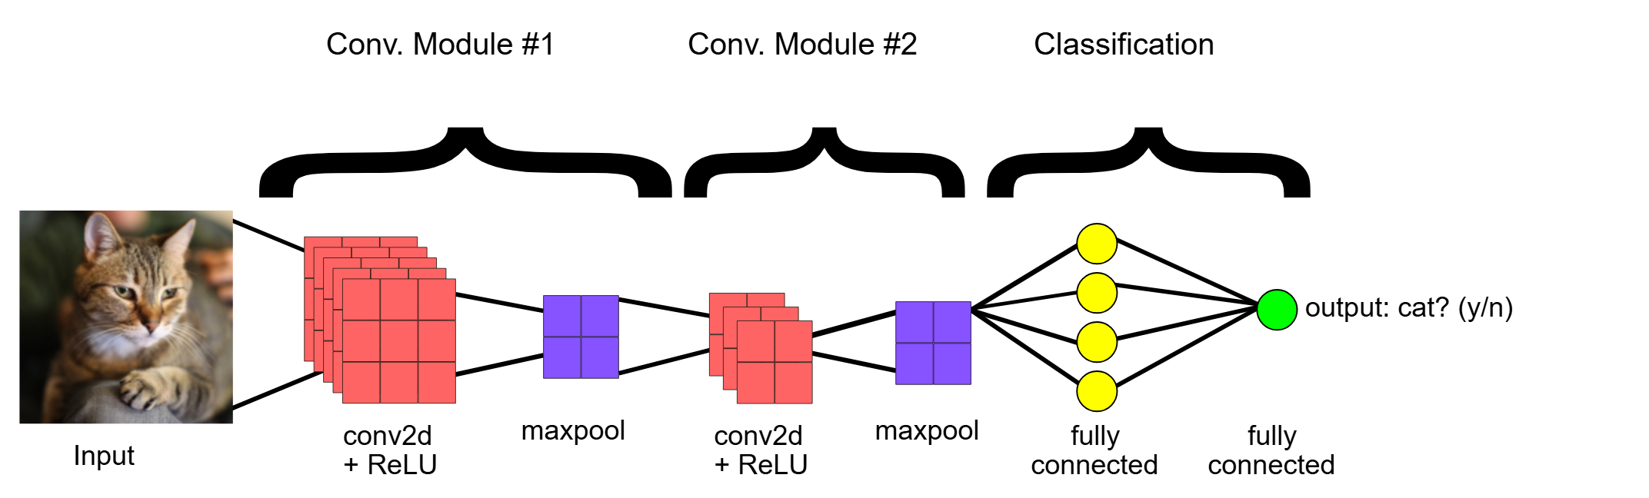
End-to-end structure of a convolutional neural network
Notes:
Convolutional Neural Networks are a form of Feedforward Neural Networks
The first part consists of convolutional and max-pooling layers which act as the feature extractor
In the above diagram, the input is fed to the network of stacked Conv, Pool and Dense layers
The second part consists of the fully connected layer which performs non-linear transformations of the extracted features and acts as the classifier
The output can be a softmax layer indicating whether there is a cat or something else. You can also have a sigmoid layer to give you a probability of the image being a cat

Slide 17
Convolutional Layer (1)
They are the fundamental building blocks of CNNs. These layers perform a critical mathematical operation known as convolution
The convolutional layer can be thought of as the eyes of the CNN
The neurons in this layer look for specific features. If they find the features they are looking for, they produce a high activation
Convolution can be thought of as a weighted sum between two signals (in terms of signal processing jargon) or functions (in terms of mathematics)
In image processing, to calculate convolution at a particular location (x, y), we extract k x k sized chunk from the image centered at location (x, y)
We then multiply the values in this chunk element-by-element with the convolution filter (also sized k x k) and then add them all to obtain a single output

Slide 18
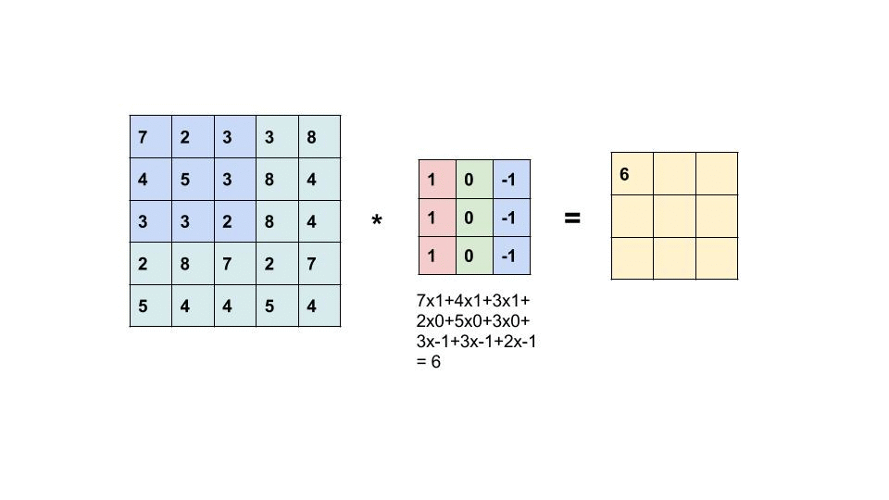
Convolutional Layer (2)
An example of convolution operation on a matrix of size 5×5 with a kernel of size 3×3 is shown below:

Slide 19
Convolutional Layer (3)
The convolution kernel is slid over the entire matrix to obtain an activation map
If the input image is of size 32x32x3 (3D array of depth 3)
The convolution filter we define at this layer must have a depth equal to the depth of the input
So we can choose convolution filters of depth 3 ( e.g. 3x3x3 or 5x5x3 or 7x7x3 etc.)
If we pick a convolution filter of size 3x3x3 (referring to the previous example, here the convolutional kernel will be a cube instead of a square)

Slide 20
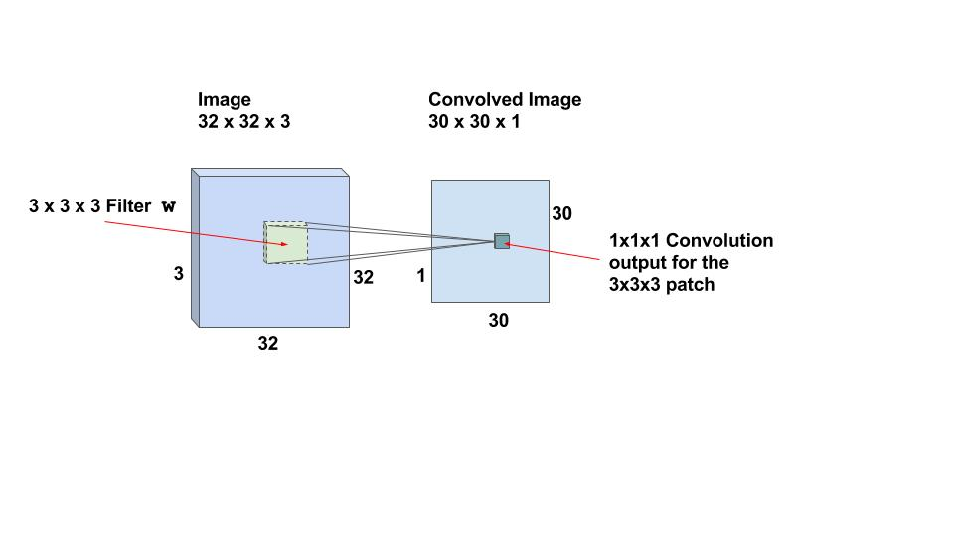
Convolutional Layer (4)
If we can perform the convolution operation by sliding the 3x3x3 filter over the entire 32x32x3 sized image, we will obtain an output image of size 30x30x1
This is because the convolution operation is not defined for a strip 2 pixels wide around the image. We have to ensure the filter is always inside the image
1 pixel is stripped away from left, right, top and bottom of the image
The same filters are slid over the entire image to find the relevant features. This makes the CNNs Translation Invariant.

Slide 21
Activation Maps
For a 32x32x3 input image and filter size of 3x3x3, we have 30x30x1 locations and there is a neuron corresponding to each location
These 30x30x1 outputs or activations of all neurons are called the activation maps
The activation map of one layer serves as the input to the next layer
In our example, there are 30×30 = 900 neurons because there are that many locations where the 3x3x3 filter can be applied
Unlike traditional neural nets where weights and biases of neurons are independent of each other, in case of CNNs the neurons corresponding to one filter in a layer share the same weights and biases
In the above case, we slid the window by 1 pixel at a time
We can also slide the window by more than 1 pixel
This number is called the stride

Slide 22
Multiple Filters
Typically, we use more than 1 filter in one convolution layer
Each filter detects features in the output of previous layer - to capture different features, learn multiple filters
If we use 32 filters we will have an activation map of size 30x30x32
Note that all neurons associated with the same filter share the same weights and biases
So the number of weights while using 32 filters is simply 3x3x3x32 = 288 and the number of biases is 32

Slide 23
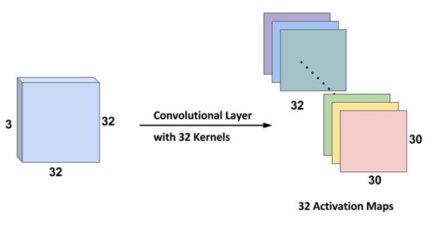
Multiple Filters
The 32 Activation maps obtained from applying the convolutional kernels

Slide 24
Zero padding
After each convolution, the output reduces in size (as in this case we are going from 32×32 to 30×30)
For convenience, it’s a standard practice to pad zeros to the boundary of the input layer such that the output is the same size as input layer
In this example, if we add a padding of size 1 on both sides of the input layer, the size of the output layer will be 32x32x32 which makes implementation simpler as well
Let’s say you have an input of size NxN, a filter of size F and you are using stride S and a zero padding of size P is added to the input image. Then, the output will be of size MxM where:
We can calculate the padding required so that the input and the output dimensions are the same by setting in the above equation and solving for P

Slide 25
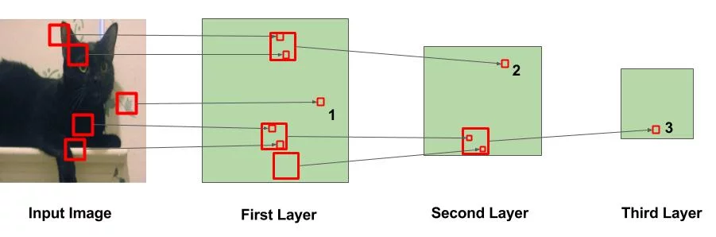
CNNs learn hierarchical features
In the above figure, the big squares indicate the region over which the convolution operation is performed and the small squares indicate the output of the operation which is just a number. The following observations are to be noted:
In the first layer, the square marked 1 is obtained from the area in the image where the leaves are painted
In the second layer, the square marked 2 is obtained from the bigger square in Layer 1. The numbers in this square are obtained from multiple regions from the input image. Specifically, the whole area around the left ear of the cat is responsible for the value at the square marked 2
Similarly, in the third layer, this cascading effect results in the square marked 3 being obtained from a large region around the leg area
We can say from the above that the initial layers are looking at smaller regions of the image and thus can only learn simple features like edges / corners etc.
As we go deeper into the network, the neurons get information from larger parts of the image and from various other neurons
The neurons at the later layers can learn more complicated features like eyes / legs

Slide 26
Activation Layer
By adding an activation function to the output of the preceding layer, activation layers add nonlinearity to the network
This layers apply an element-wise activation function to the output of the convolution layer
Some common activation functions are RELU: max(0, x), Tanh, Leaky RELU, etc.
The volume remains unchanged hence output volume will have dimensions 32 x 32 x 32

Slide 27
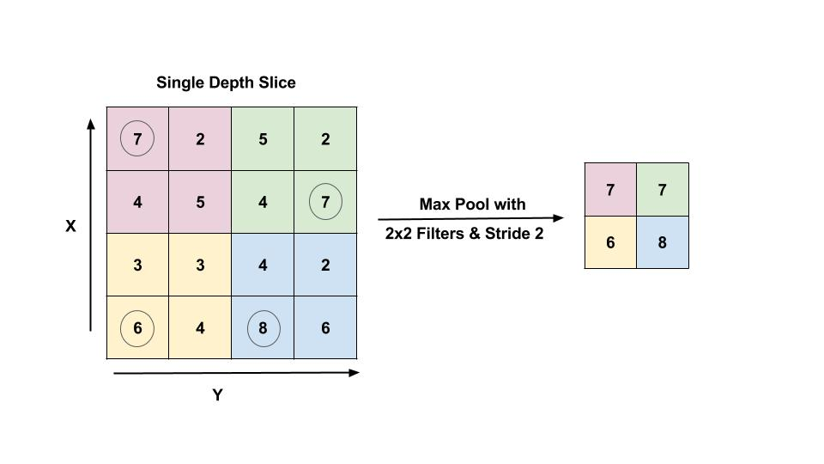
Max Pooling Layer
Pooling layer is mostly used immediately after the convolutional layer to reduce the spatial size (only width and height, not depth)
This reduces the number of parameters, hence computation is reduced. Using fewer parameters avoids overfitting
The most common form of pooling is Max pooling where we take a filter of size p and apply the maximum operation over the sized part of the image.
Notes:
Figure : Max pool layer with filter size 2×2 and stride 2 is shown. The output is the max value in a 2×2 region shown using encircled digits.
The most common pooling operation is done with the filter of size 2×2 with a stride of 2. It essentially reduces the size of input by half.

Slide 28

Flattening layers
After convolutional and pooling layers have extracted relevant features from the input image we have to turn this high-dimensional feature map into a format suitable for feeding into fully connected layers
Imagine you have a grid of data (like pixels in a feature map), and you want to line up all of these grid points in a single, long line

Slide 29
Fully-connected layer
At the end of a convolutional neural network are one or more fully connected layers (when two layers are "fully connected," every node in the first layer is connected to every node in the second layer)
Their job is to perform classification based on the features extracted by the convolutions. Typically, the final fully connected layer contains a softmax activation function, which outputs a probability value from 0 to 1 for each of the classification labels the model is trying to predict

Slide 30
Implementing CNNs in PyTorch

Slide 31
Problem statement
Image classification
Implement a Convolutional Neural Network in PyTorch to solve the problem

Slide 32
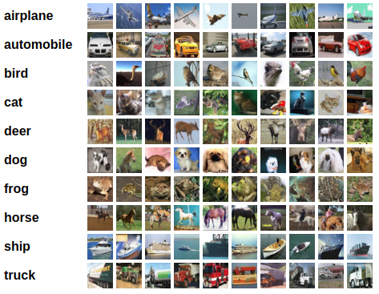
Dataset
CIFAR10 dataset
50K training images and 10K test images
There are 10 classes like airplanes, automobiles, birds, cats, deer, dog, frog, horse, ship and truck
The images are of size 32×32

Slide 33
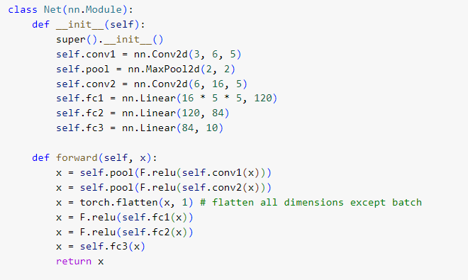
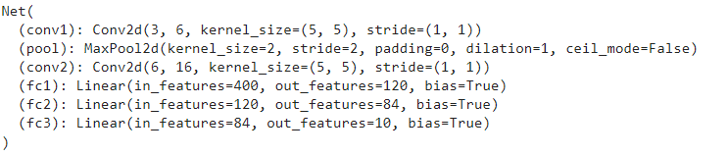
Simple Network Architecture
Notes:
Xavier uniform initializer.
It draws samples from a uniform distribution within limit obtained using the number of input units and the number of output units in the weight tensor

Slide 34
Training the network
We have a 10 class classification problem, we will use a categorical cross entropy loss and use Adam optimizer to train the network
We train the network in N epochs

Slide 35
Data Augmentation (1)
One of the major reasons for overfitting is that you don’t have enough data to train your network
Apart from regularization, another very effective way to counter overfitting is Data Augmentation
It is the process of artificially creating more images from the images you already have by changing the size, orientation etc. of the image
It can be a tedious task but fortunately, this can be done in PyTorch using the ImageDataGenerator instance

Slide 36
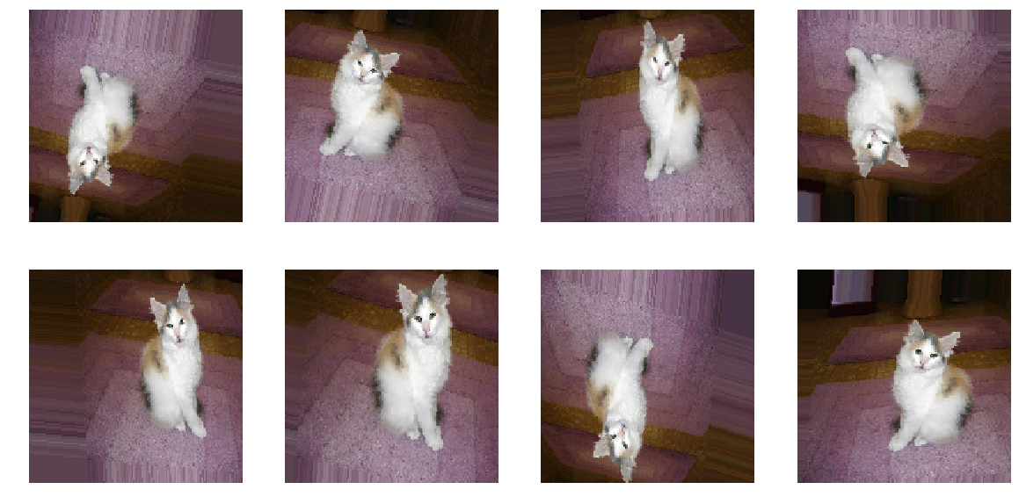
Data Augmentation (2)
from torchvision import datasets,transforms
transforms = transforms.Compose([
#resises the image so it can be perfect for our model.
transforms.Resize((32,32)),
# Flips the image w.r.t horizontal axis
transforms.RandomHorizontalFlip(),
#Rotates the image to a specified angel
transforms.RandomRotation(10),
#Performs actions like zooms, change shear angles.
transforms.RandomAffine(0, shear=10, scale=(0.8,1.2)),
# Set the color params
transforms.ColorJitter(brightness=0.2, contrast=0.2, saturation=0.2),
# convert the image to tensor so that it can work with torch
transforms.ToTensor(),
#Normalize all the images
transforms.Normalize((0.5, 0.5, 0.5), (0.5, 0.5, 0.5))
])
This includes rotation of the image, shifting the image left/right/top/bottom by some amount, flip the image horizontally or vertically, shear or zoom the image etc.

Slide 37
What next?
Lot of parameters to chose from and then training took a long time
We would not want to get tied down with these two problems when we are working on simple problems
Many open source trained models which have been trained on millions of images and for hundreds of hours on many GPUs
We can leverage their models and try to use their trained models as the starting point rather than starting from scratch
Learn how to do Transfer Learning and Fine-tuning

Slide 38
ImageNet and ILSVRC
ImageNet is a project which aims to provide a large image database for research purposes
It contains more than 14 million images which belong to more than 20,000 classes (or synsets )
They also provide bounding box annotations for around 1 million images, which can be used in Object Localization tasks
ImageNet Large Scale Visual Recognition Challenge (ILSVRC) is an annual competition organized by the ImageNet team since 2010, where research teams evaluate their computer vision algorithms various visual recognition tasks such as Object Classification and Object Localization
The training data is a subset of ImageNet with 1.2 million images belonging to 1000 classes. Deep Learning came to limelight in 2012 when Alex Krizhevsky and his team won the competition by a margin of a excellent 11%

Slide 39
Why use pre-trained models? (1)
A pre-trained model is trained on a different task than the task at hand but provides a very useful starting point because the features learned while training on the old task are useful for the new task
We have seen earlier that we can create and train small convolutional networks (CNNs) to classify different objects (using CIFAR10)
These small networks fall short when there are many classes and the objects vary in size / shape / appearance etc., as the model lacks the complexity which is required to model such large variations in data
Even though it is possible to model any function using just a single hidden layer theoretically, but the number of neurons required to do so would be very large, making the network difficult to train
Thus, we use deep networks with many hidden layers which try to learn different features at different layers as we saw in the previous slides on CNNs

Slide 40
Why use pre-trained models? (2)
Deep networks have a large number of unknown parameters (in millions)
The task of training a network is to find the optimum parameters using the training data
For finding all the unknown parameters accurately, we would need a lot of data (in millions)
If we have very few data, we will get only approximate values for most of the parameters, which we don’t want
For Deep Networks – More data -> Better learning

Slide 41
Why use pre-trained models? (3)
The problem is that it is difficult to get such huge labeled datasets for training the network
Another problem, related to deep networks is that even if you get the data, it takes a large amount of time to train the network (hundreds of hours)
Thus, it takes a lot of time, money and effort to train a deep network successfully
Fortunately, we can leverage the models already trained on very large amounts of data for difficult tasks with thousands of classes
Many Research groups share the models they have trained for competitions like ILSVRC
The models have been trained on millions of images and for hundreds of hours on powerful GPUs
Most often we use these models as a starting point for our training process, instead of training our own model from scratch

Slide 42
Models and pre-trained weights
The torchvision.models subpackage contains definitions of models for addressing different tasks, including: image classification, pixelwise semantic segmentation, object detection, instance segmentation, person keypoint detection, video classification, and optical flow
The following classification models are available, with or without pre-trained weights:
AlexNet, ConvNeXt, DenseNet, EfficientNet, EfficientNetV2, GoogLeNet, Inception V3, MaxVit, MNASNet, MobileNet V2, MobileNet V3, RegNet, ResNet, ResNeXt, ShuffleNet V2, SqueezeNet, SwinTransformer, VGG, VisionTransformer, Wide ResNet

Slide 43
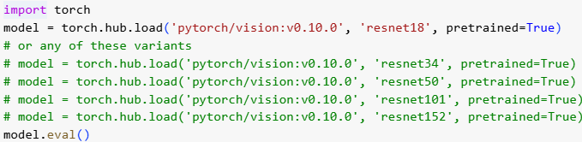
Initializing pre-trained models

Slide 44
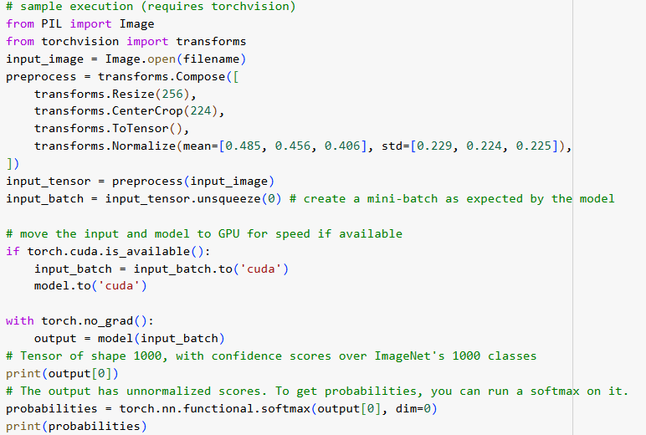
Loading and pre-processing an image

Slide 45
Transfer Learning and Fine-tuning using pre-trained models
Pre-trained models can identify objects/categories only from the ones that are used during the learning phase
How to use pre-trained models as a Feature Extractor and train a new model for a different classification task

Slide 46
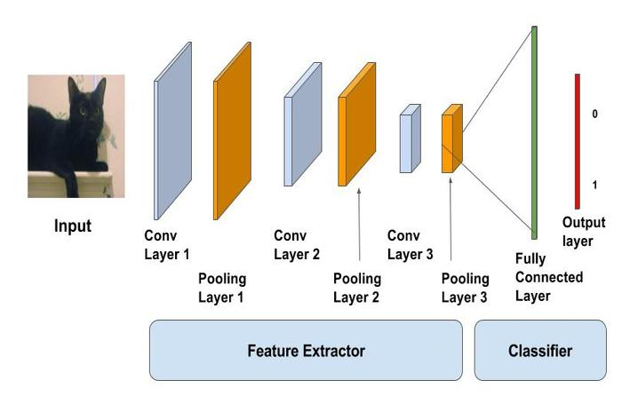
Transfer Learning vs Fine-tuning (1)
The pre-trained models are trained on very large scale image classification problems. The convolutional layers act as feature extractor and the fully connected layers act as Classifiers.

Slide 47
Transfer Learning vs Fine-tuning (2)
Since these models are very large and have seen a huge number of images, they tend to learn very good, discriminative features
We can either use the convolutional layers merely as a feature extractor or we can tweak the already trained convolutional layers to suit our problem at hand
The former approach is known as Transfer Learning and the latter as Fine-tuning
As a rule of thumb: when we have a small training set and our problem is similar to the task for which the pre-trained models were trained, we can use transfer learning. If we have enough data, we can try and tweak the convolutional layers so that they learn more robust features relevant to our problem

Slide 48
Fine-tuning
The task of fine-tuning a network is to tweak the parameters of an already trained network so that it adapts to the new task at hand
The initial layers learn very general features and as we go higher up the network, the layers tend to learn patterns more specific to the task it is being trained on
Thus, for fine-tuning, we want to keep the initial layers intact (or freeze them) and retrain the later layers for our task
Fine-tuning avoids the following limitations:
The amount of data required for training is not much because of two reasons. First, we are not training the entire network. Second, the part that is being trained is not trained from scratch
Since the parameters that need to be updated is less, the amount of time needed will also be less

Slide 49
Fine-tuning pipeline
Download and prepare data
Load the pre-trained model
Freeze the required layers
In PyTorch, the parameters have a property called “requires_grad”. For freezing the weights of a particular layer, we should set this parameter to False, indicating that this parameter should not be trained
We go over each parameter and select which parameters we want to train (freeze the parameters except the parameters from for example the last 4 layers)

Slide 50
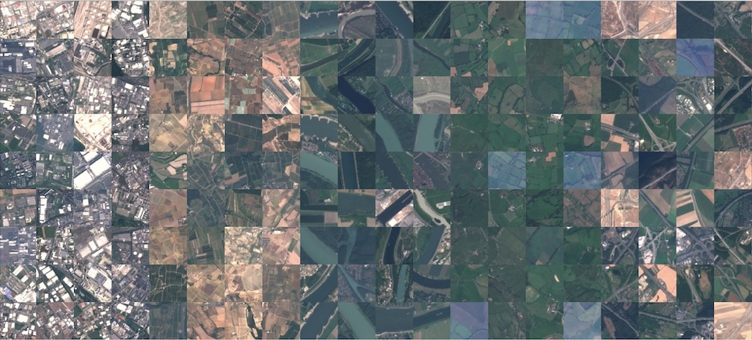
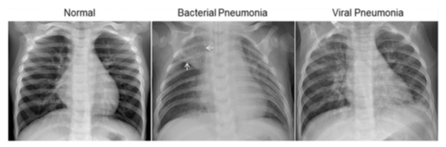
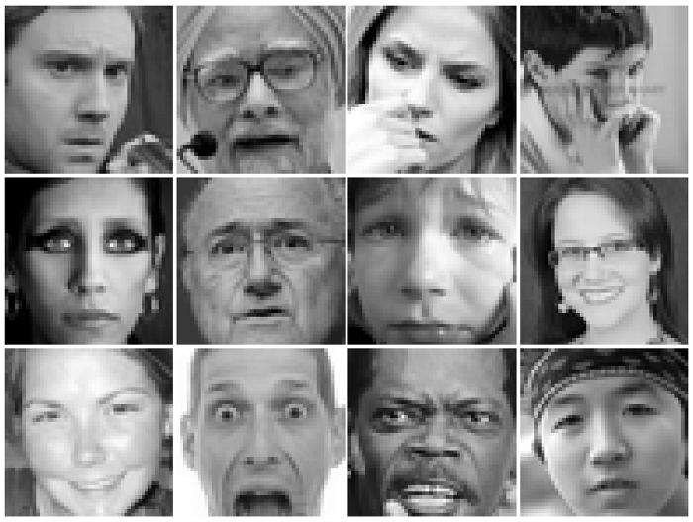
Project Ideas (1)
EuroSAT: Land Use and Land Cover Classification with Sentinel-2
https://github.com/phelber/EuroSAT?tab=readme-ov-file
Classification of Chest X-Ray Images (Pneumonia)
https://www.kaggle.com/datasets/paultimothymooney/chest-xray-pneumonia
Learn facial expressions from an image
https://www.kaggle.com/datasets/msambare/fer2013

Slide 51
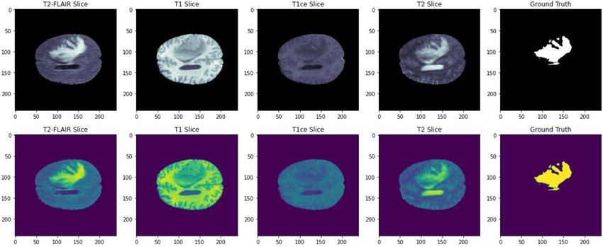
Project Ideas (2)
Segmentation of brain tumors in multimodal magnetic resonance imaging (MRI) scans
https://www.kaggle.com/datasets/awsaf49/brats20-dataset-training-validation/data

